Slide 1
Course Content simplification agent
IBM AICTE PROJECT
Presented By:
Student name : Shinde Vaishnavi Vinod
College Name & Department : MIT Academy of Engineering, Electronics Engineering

Slide 2
OUTLINE
Problem Statement
Technology used
Wow factor
End users
Result
Conclusion
Git-hub Link
Future scope
IBM Certifications

Slide 3
Problem Statement
Educational materials often vary in complexity and are not always accessible to learners with different levels of prior knowledge. Students may struggle to grasp key concepts due to jargon heavy or overly advanced explanations in faculty notes and textbooks.
The solution is to develop an AI powered agent that can intelligently analyze academic content and reframe explanations based on the learner's current proficiency—ranging from beginner to expert. This would support more inclusive learning and personalized education delivery at scale.

Slide 4
Technology used
IBM cloud lite services
Natural Language Processing (NLP)
Retrieval Augmented Generation (RAG)
IBM Granite model

Slide 5
IBM cloud services used
IBM Cloud Watsonx AI Studio
IBM Cloud Watsonx AI runtime
IBM Cloud Agent Lab
IBM Granite-3-3-8b-instruct foundation model

Slide 6
Wow factors
It takes really complicated stuff and turns it into easy, interesting explanations that actually make sense. Whether you’re a beginner or already know a lot, it adjusts to you. It saves tons of time, helps you really understand topics, and makes learning way less stressful.
It includes:
It can explain things at any level — beginner, intermediate, or advanced.
Let’s you choose how you want it: quick definitions, bullet notes, tables, charts, or full detailed explanations.
Always adds real-life examples so it’s easier to relate and remember.
Breaks down big, complicated paragraphs into simple notes.
Can explain in different languages.
Even gives links to books, research papers, and other sources if you want to go deeper.
Adjusts how it talks — whether you just need a quick summary or a deep dive for a project.

Slide 7
End users
Students
Faculty & Teachers
Researchers & Academics
Professionals & Lifelong Learners
Institutions

Slide 8
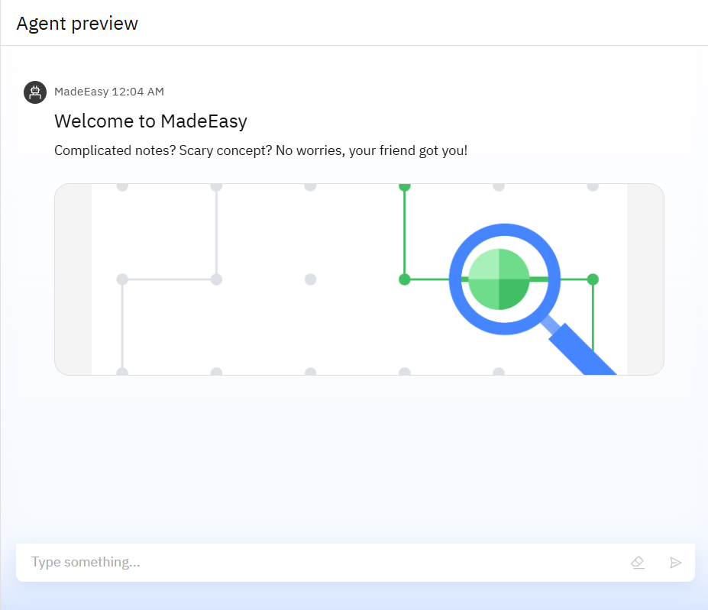
Results

Slide 9
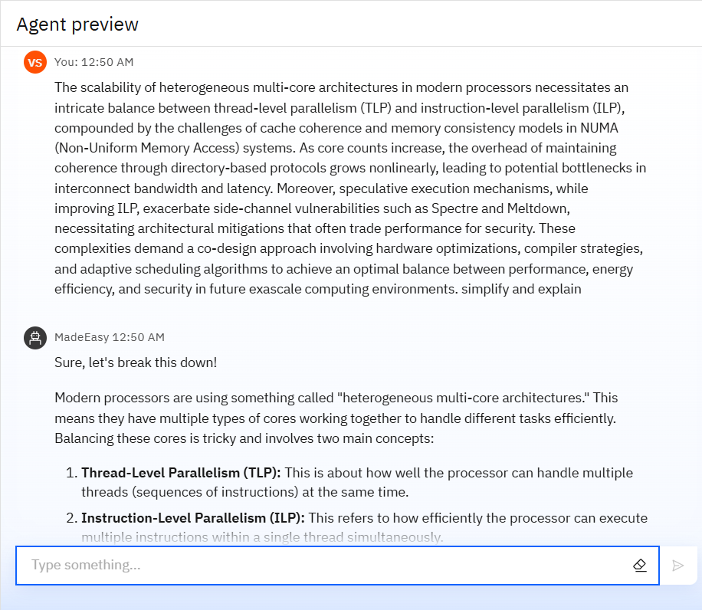
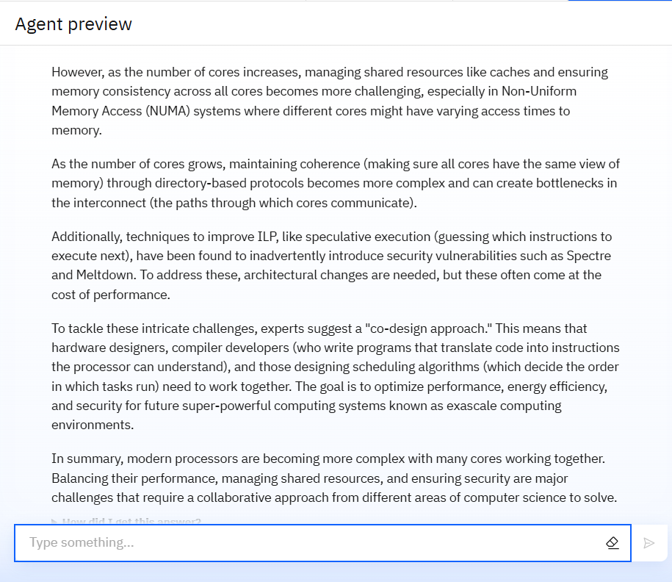
Results

Slide 10
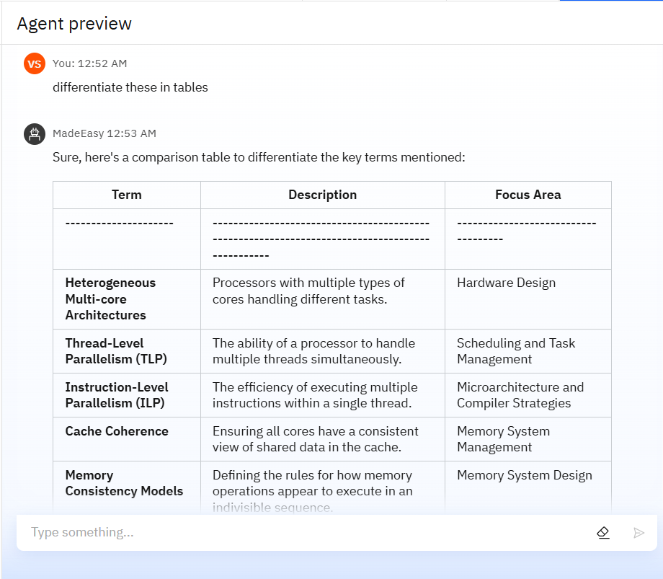
Results

Slide 11
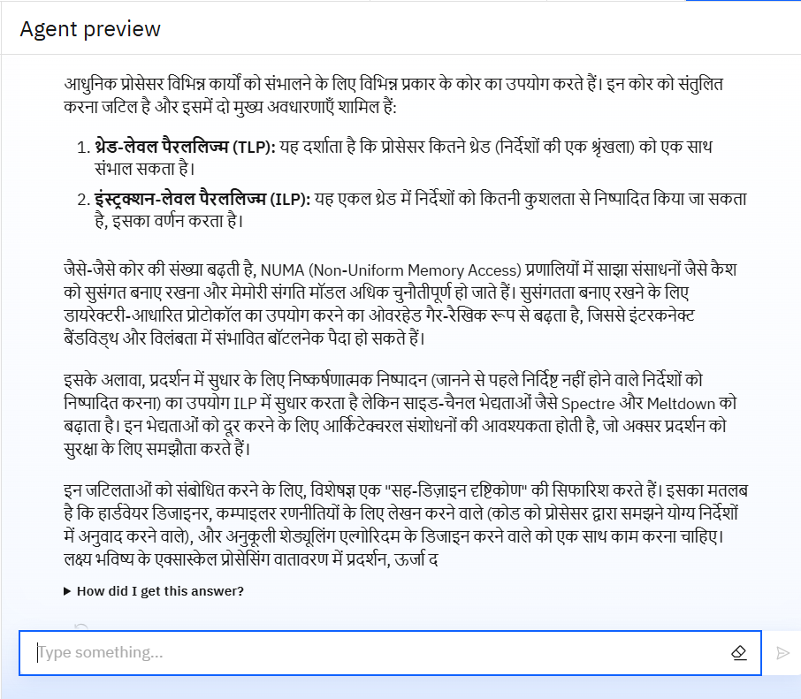
Results

Slide 12
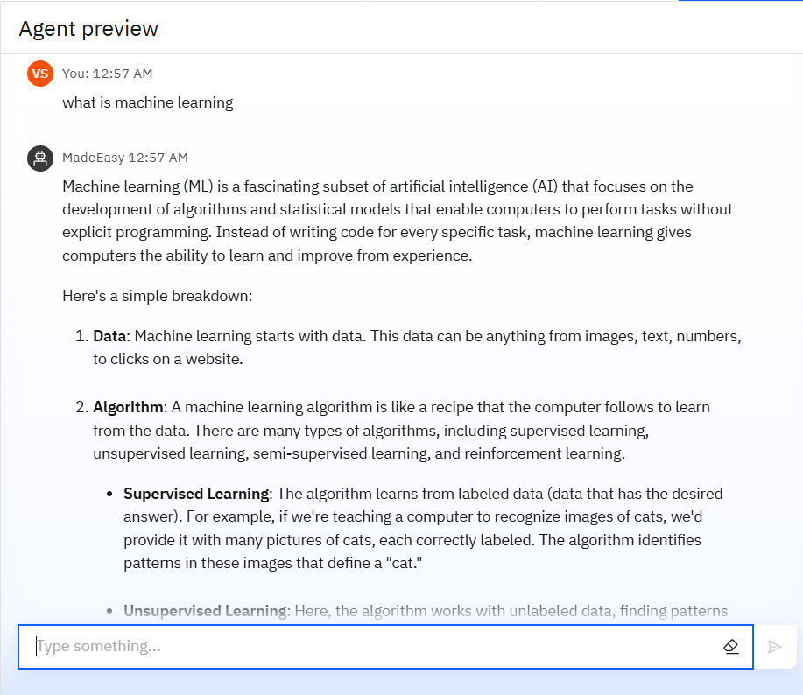
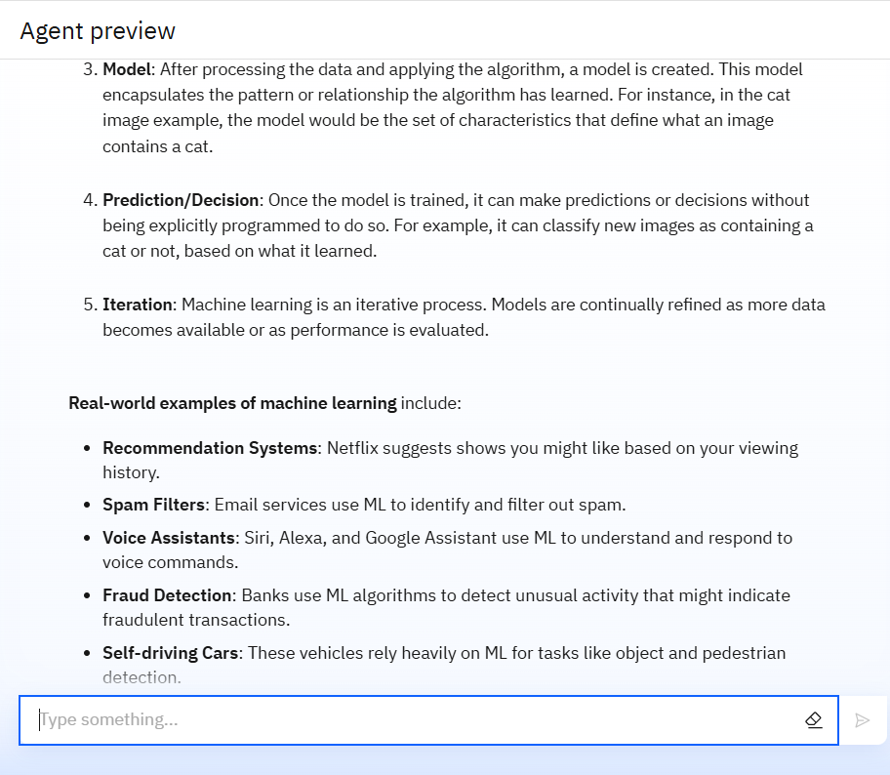
Results

Slide 13
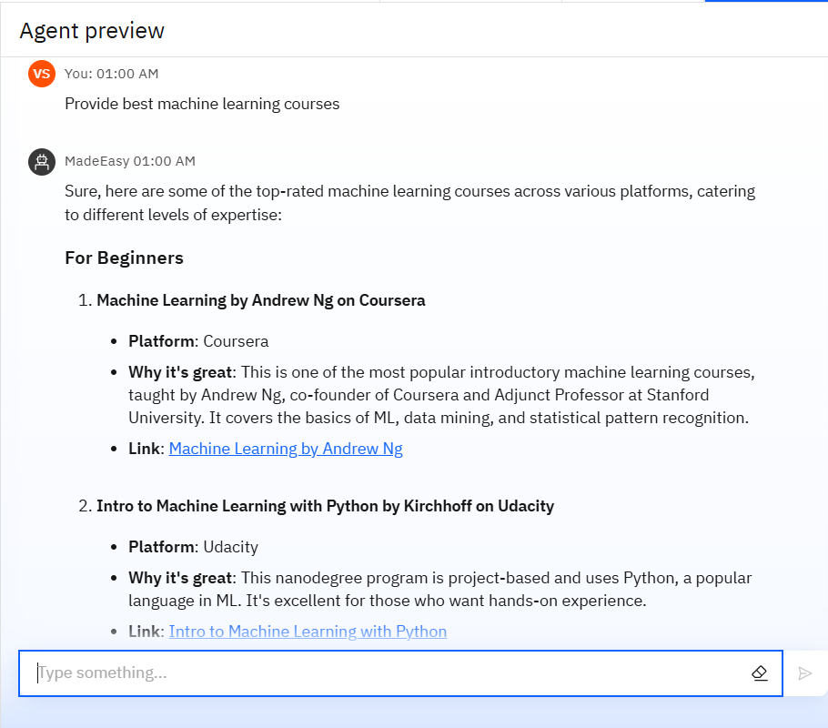
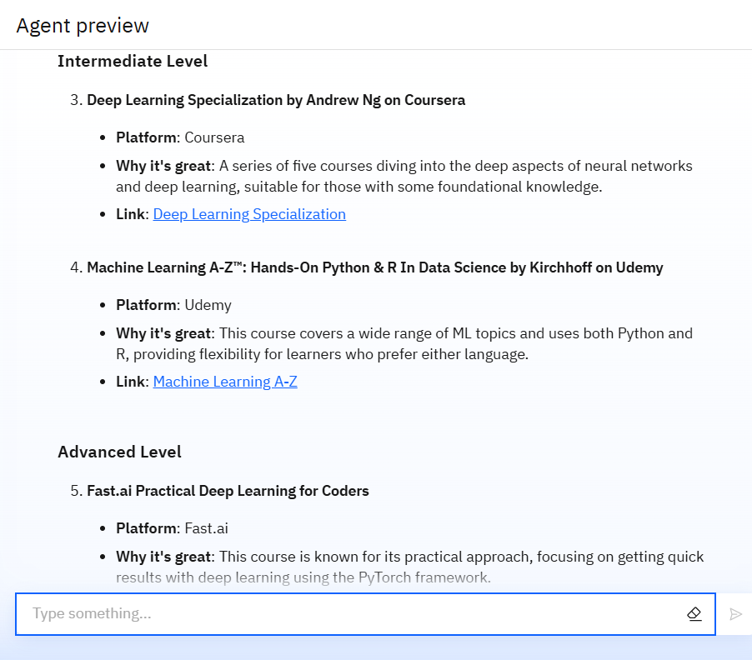
Results

Slide 14
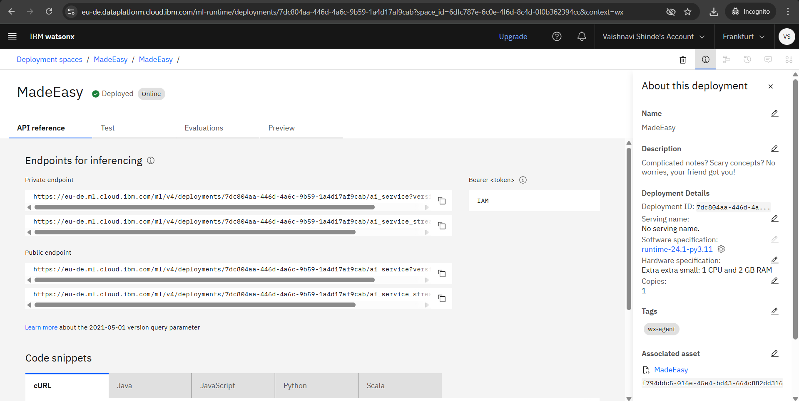
Results
API reference

Slide 15
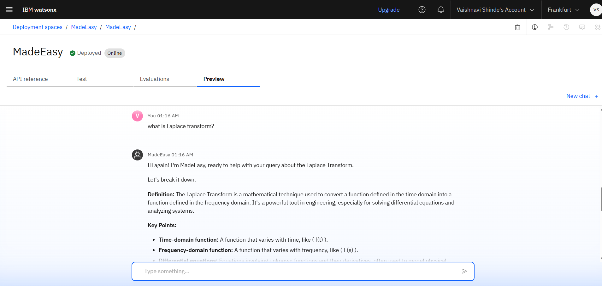
Results
Deployed AI Agent

Slide 16
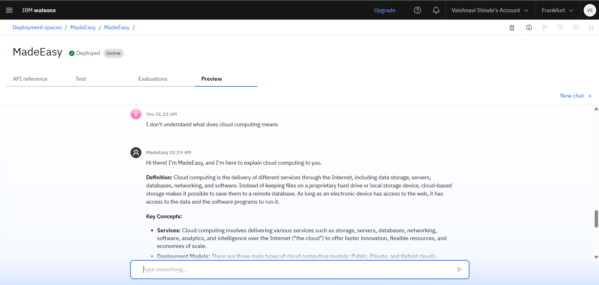
Results
Deployed AI Agent

Slide 17
Conclusion
The agent can simplify the hard course content into easy explanations with real world examples if needed.
It is able to explain in different languages so that any user can understand it.
It is able to recommend reference books for related topic.
Saves time and reduces stress by simplifying even the hardest topics.

Slide 18
Future scope
Multilingual Learning Expansion
Interactive Learning
Multimedia Integration
Accessibility Features like text-to-speech, sign language videos.
Integration with Learning Management Systems (LMS)
Personalized study plans
AI-Powered Assessment Tools

Slide 19
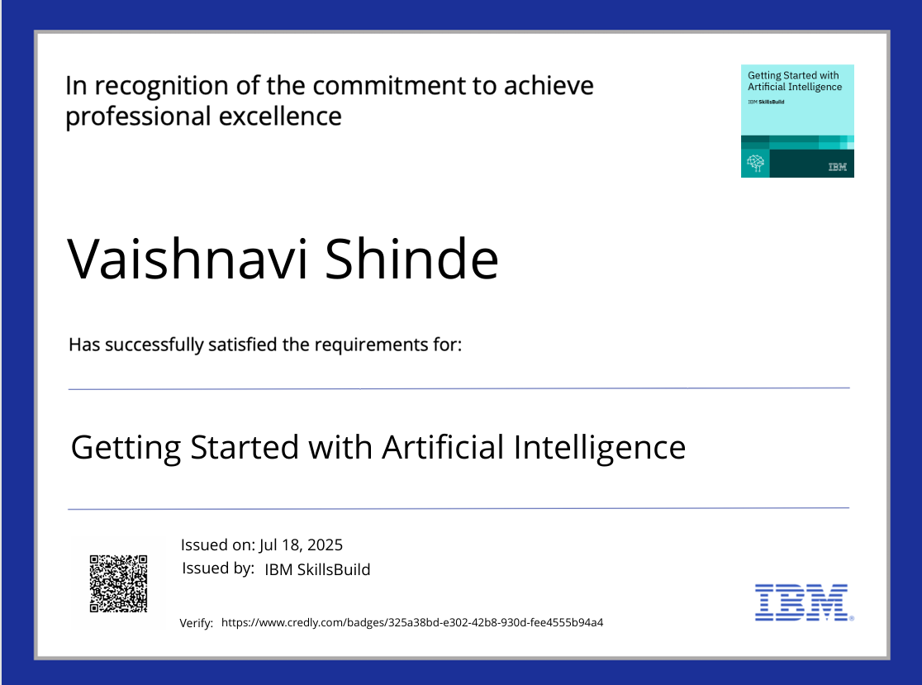
IBM Certifications

Slide 20
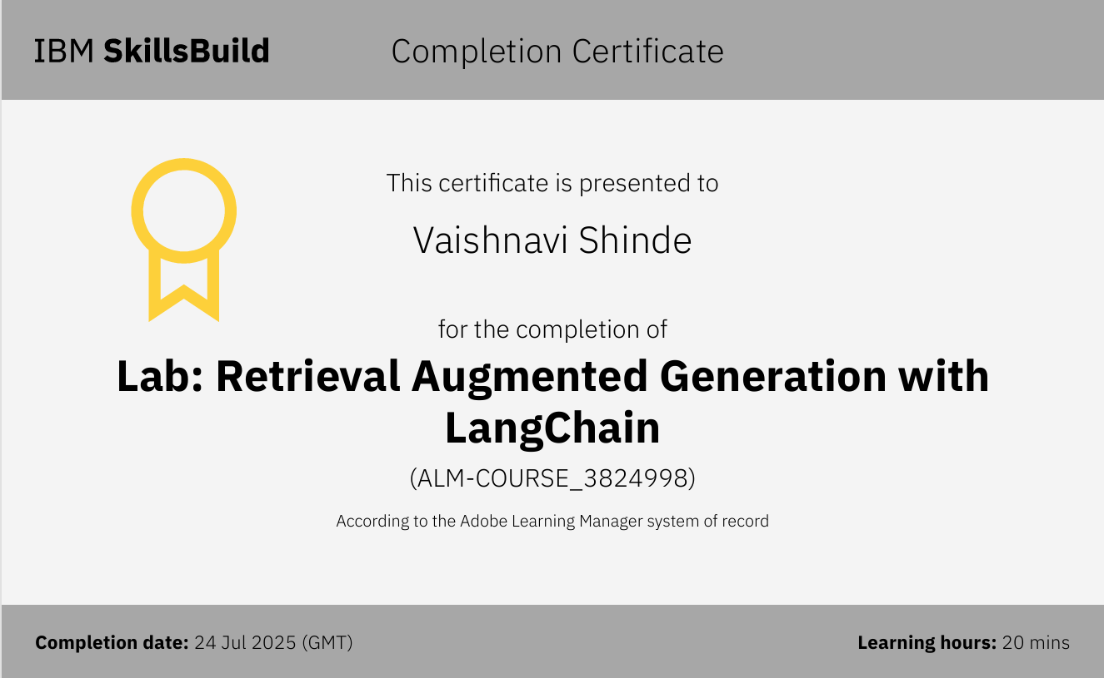

Slide 21
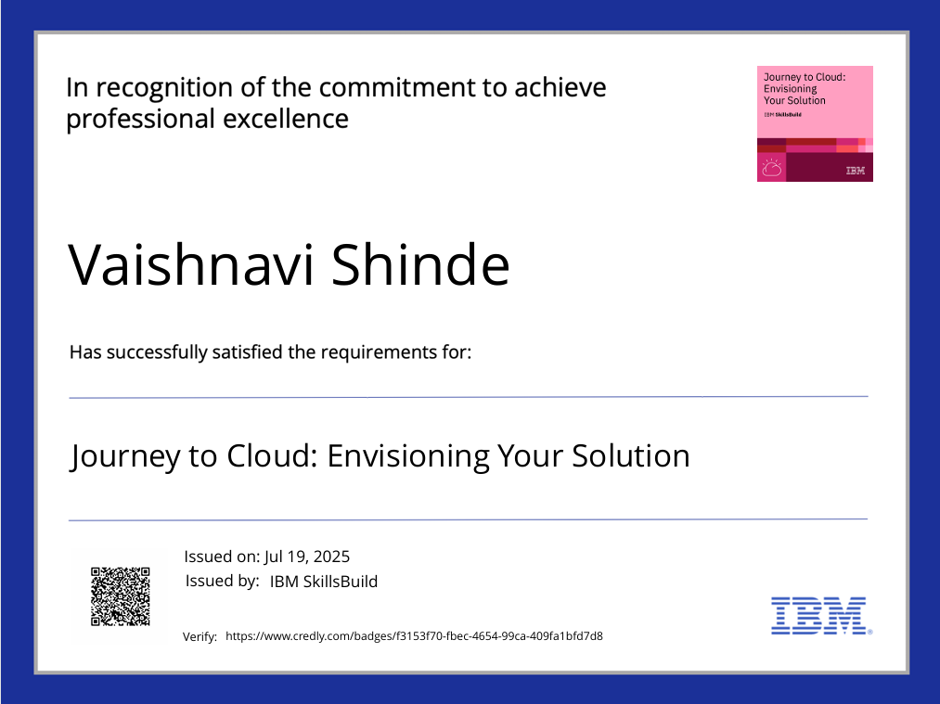

Slide 22
THANK YOU

